Slide 1


Endpoint x University of Sheffield
Eleanor R. A. Hyde and Claudia C. von Bastian 03/03/2023

Slide 2
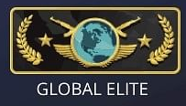


PhD Topic
Cognition
FPS play
FPS Expertise
FPS play may enhance a range of cognitive abilities such as perception, top-down attention and spatial cognition (Bediou et al., 2018; Sala et al., 2018)
However, the findings are mixed - perhaps due to some methodological weaknesses such as varying definitions of FPS games, small samples of novice players, single measures of FPS expertise and short FPS training periods. There may also be a relationship between FPS play and expertise, with highly expert eSports players perhaps showing greater cognitive performance benefits than less expert players (Bavelier, Bediou & Green, 2018).
Notes:
Bediou et al., 2018: https://learningtransferlab.wiscweb.wisc.edu/wp-content/uploads/sites/280/2017/11/Bediou_et_al_PsychBull_2017.pdf Sala et al., 2018: https://eprints.lse.ac.uk/102169/1/Video_games_draft_Rev2_FINAL_correct.pdf
Bavelier, Bediou & Green, 2018: https://www.sciencedirect.com/science/article/pii/S2352154617301122?casa_token=Ul93b7wnu4QAAAAA:2i1jdpIV7oaJDAOkkYJJ1TqEEFGE7gxrAJixyv_bxl_84y5Ww8nuMruLNqiFNFFB5xUtaQRjmJw

Slide 3
Eleanor’s PhD Plan
Study 1
Study 3
Study 2
Does expertise in playing CS relate to information processing speed and cognitive flexibility?
Does expertise in playing CS relate to the ability to learn?
Study 4
Focus group
TBC…
Pilot testing
Interviews
What is CS expertise?
In collaboration with University and Professional eSports teams

Slide 4
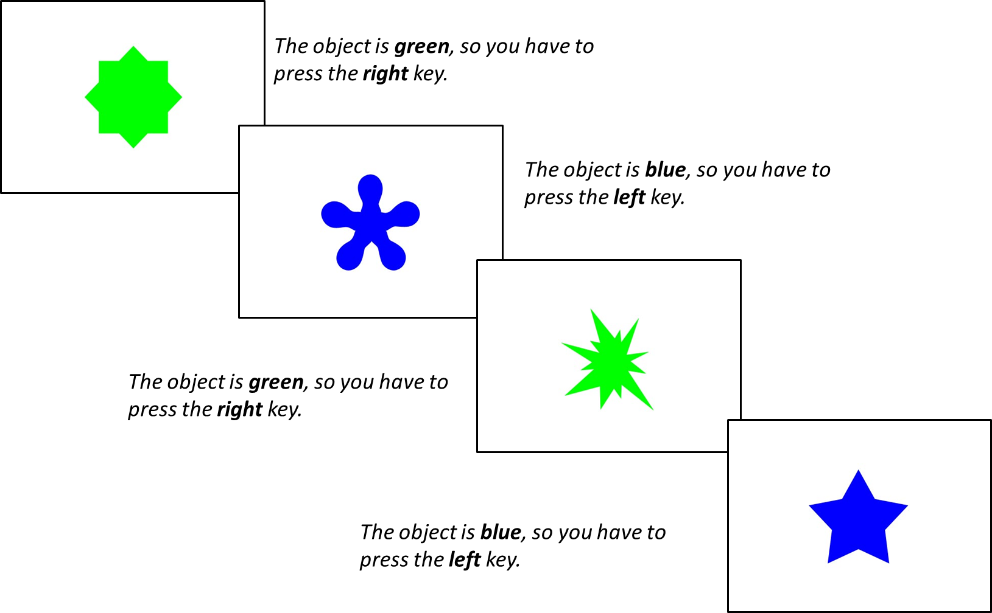

Study 1
RQ: Does expertise in playing CS relate to information processing speed and cognitive flexibility?
Professional
Expert
Casual
Questionnaire
Total hours playtime
Weekly hours playtime
Current Ranking (Standard MM)
Self-rated expertise

Slide 5
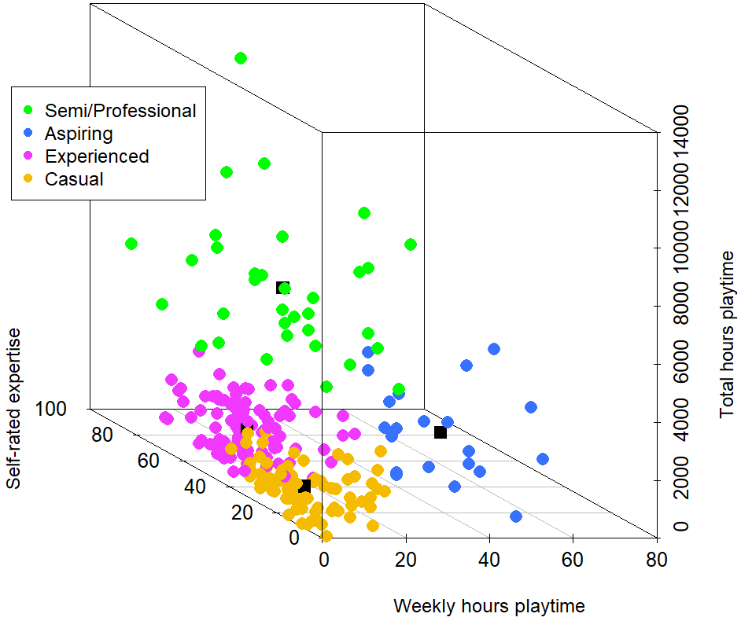
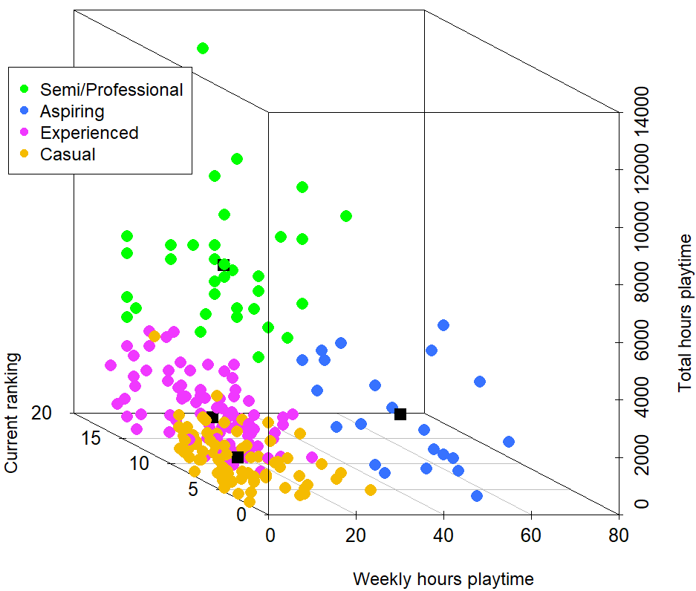
CS: GO Expertise: K-means clustering

Slide 6
Processing Speed in Single-rule trials
p = .001

Slide 7
Processing Speed in Repetition-rule trials
p = .036

Slide 8
Processing Speed in Switch-rule trials
p = .250

Slide 9
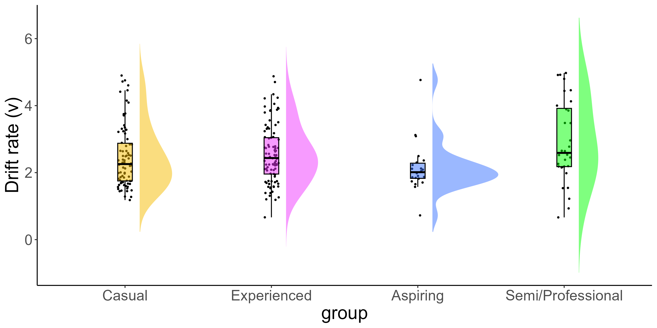
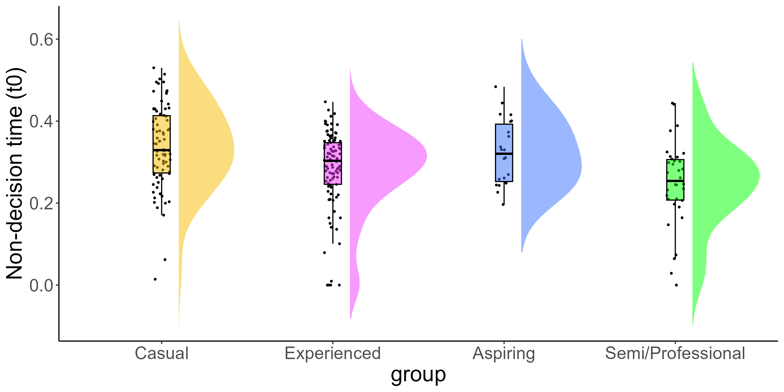
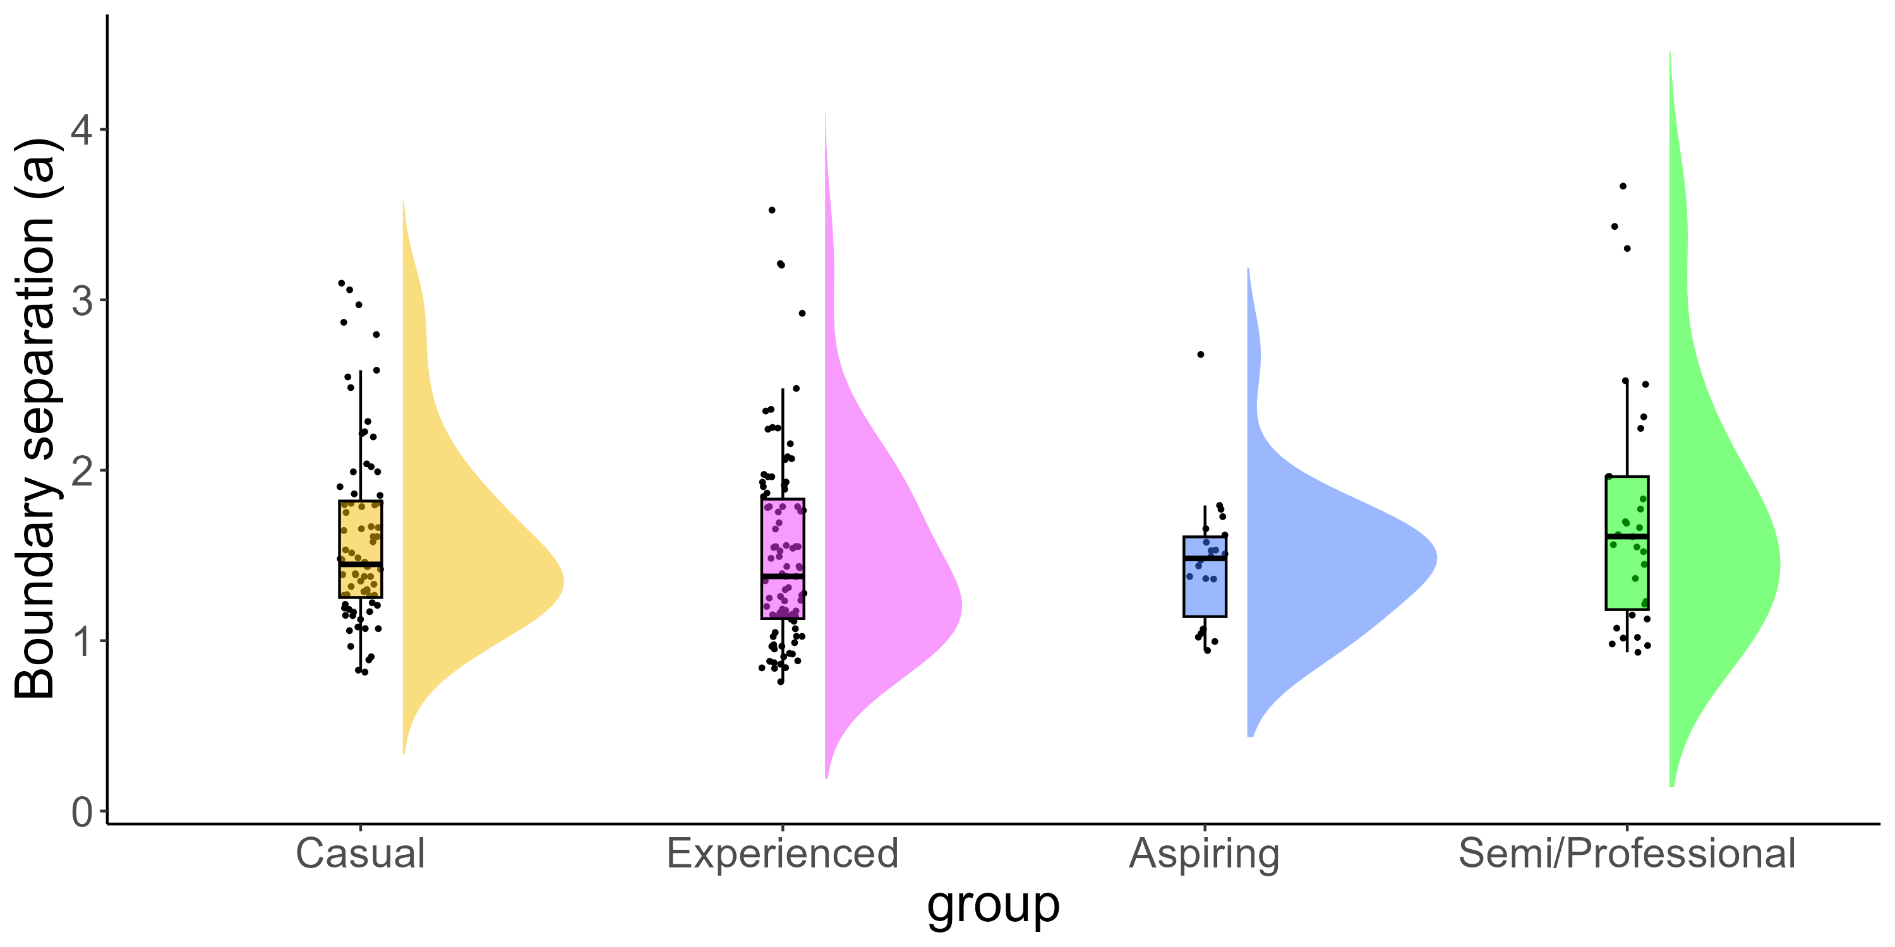
Decision Making: Drift-Diffusion Modelling
p = .010
p = .001
p = .250

Slide 10
What’s next and how could Endpoint help?
Study 1
Study 3
Study 2
Does expertise in playing CS relate to information processing speed and cognitive flexibility?
Does expertise in playing CS relate to the ability to learn?
Study 4
Focus group
TBC…
Pilot testing
Interviews
What is CS expertise?
In collaboration with University and Professional eSports teams
Insomnia
Endpoint HQ

